Slide 1
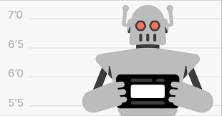

Bot Analysis
r/place 2023 (v2)
Daniel Hill, Toby Guenthner, & Ryan Perez
Notes:
Ryan

Slide 2
Our Methods
Jupyter Lab running on Amazon Sagemaker
Parquet file in an S3 bucket
Noticed bot activity by watching rplace timelapse

Slide 3

Interactive Timelapse
https://place.ifies.com/2023/#x1861y811z1

Slide 4
Timelapse (18:14 to 18:16) – June 25
This is odd...

Slide 5
Hypothesis:
Botting service repository: https://github.com/michaelshumshum/r-placer
“bot that takes an input image, location, and account login to draw to the r/place canvas. .. Supports multiple accounts“
Account maker script w/ VPN to bypass timeouts per IP

Slide 6
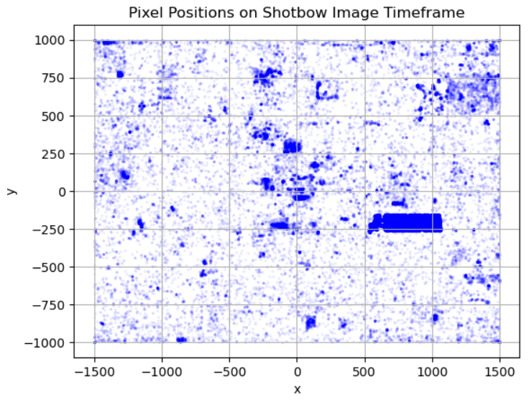
Heatmap showing pixel placements in the 2 minute window where SHOTBOW was placed
18:14-18:16

Slide 7
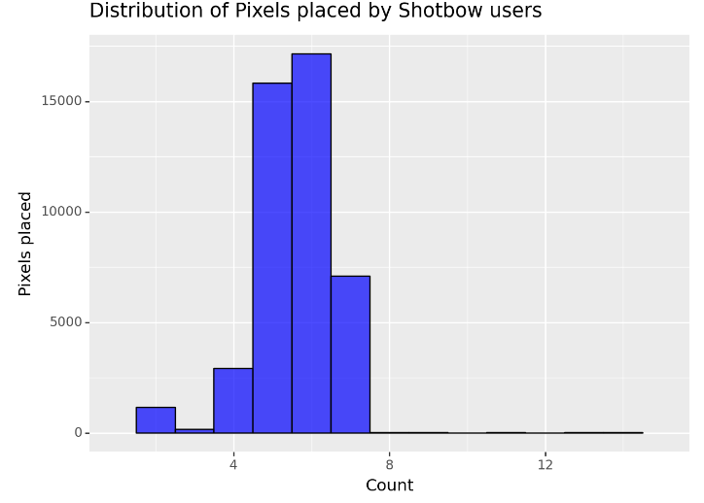
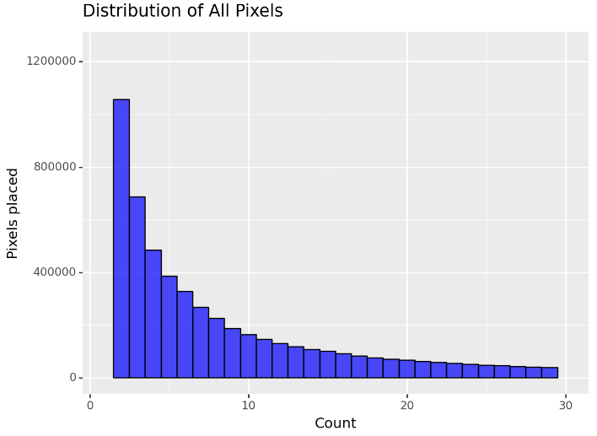

Slide 8
https://youtu.be/-to6VpTEKD0

Slide 9
Questions?

